Slide 2
Unit 5: Probability Concept and Random Numbers (7 hrs)
5.1 Stochastic System
5.2 Discrete and Continuous Probability Function
5.3 Random Numbers Versus Pseudo Random Numbers
5.4 Properties of Random Numbers
5.5 Random Number Generation Techniques
5.5.1 Linear Congruential Generator
5.5.2 Mixed Generator
5.5.3 Additive and Incremental Generator
5.6 Test for Randomness
5.6.1 Uniformity Test (KS Test, Chi Square Test)
5.6.2 Independence Test (Run Test (Above and Below, Up and Down, Lengths of Runs), Test for Auto Correlation, Gap Test, Poker Test)

Slide 3
Probability Concept
Probability theory is applied to situations where uncertainty exists.
In our daily life, we have many situations where uncertainty plays a vital role.
The chance of rain tomorrow is 40%.
This means, the probability of rain 0.4.

Slide 4
Stochastic vs Deterministic
The description of activities can be of two type: Deterministic and Stochastic.
The process in which the outcome of an activity can be described completely in terms of its input is deterministic.
On the other hand, when the outcome of an activity is random i.e. there can be various possible outcomes, the activity is said to be stochastic.

Slide 5
Stochastic vs Deterministic
In case of an automatic machine, the output per hour is deterministic, while in a repair shop, the number of machine repaired will vary from hour to hour in random fashion.
The term random and stochastic are interchangeable.

Slide 6
Random Variables
A random variable is a rule that assigns a number to each outcome of an experiment.
These numbers are called values of a random variable. Random variables are usually denoted by X.
Example:
If a die is rolled out, the outcome has a value from 1 through 6.
If a coin is tossed, the possible outcome is head ‘H’ or tail ‘T’.

Slide 7
Random Variables
There are two types of random variables:
Discrete Random Variable
Continuous Random Variable

Slide 8
Discrete Random Variable
A discrete random variable takes only specific, isolated numerical values.
The variables which take finite numeric values are called as Finite discrete random variables and which takes unlimited values are called as Infinite discrete random variables.
The examples are shown in the table below:
Random Variables | Values | Types
Flip a coin three times; X = the total number of heads | {0, 1, 2, 3} | Discrete Finite There are only four possible values for X.
Select a mutual fund; X = the number of companies in the fund portfolio. | {2, 3, 4, ...} | Discrete Infinite There is no stated upper limit to the size of the portfolio.

Slide 9
Continuous Random Variable
A discrete random variable takes only specific, isolated numerical values.
The variables which take finite numeric values are called as Finite discrete random variables and which takes unlimited values are called as Infinite discrete random variables.
The examples are shown in the table below:
Random Variables | Values | Types
Measure the length of an object; X = its length in centimeters. | Any positive real number | Continuous. The set of possible measurements can take on any positive value.

Slide 10
Random Variables
A random variable x is called discrete if the number of possible values of x (i.e. range space) is finite or countably infinite, i.e. possible values of x maybe x1, x2, …, xn.
A random variable x is called continuous if its range space is an interval or a collective of intervals.
A continuous variable can assume value over a continuous range.
A stochastic process is described by a probability law called Probability Density Function.

Slide 11
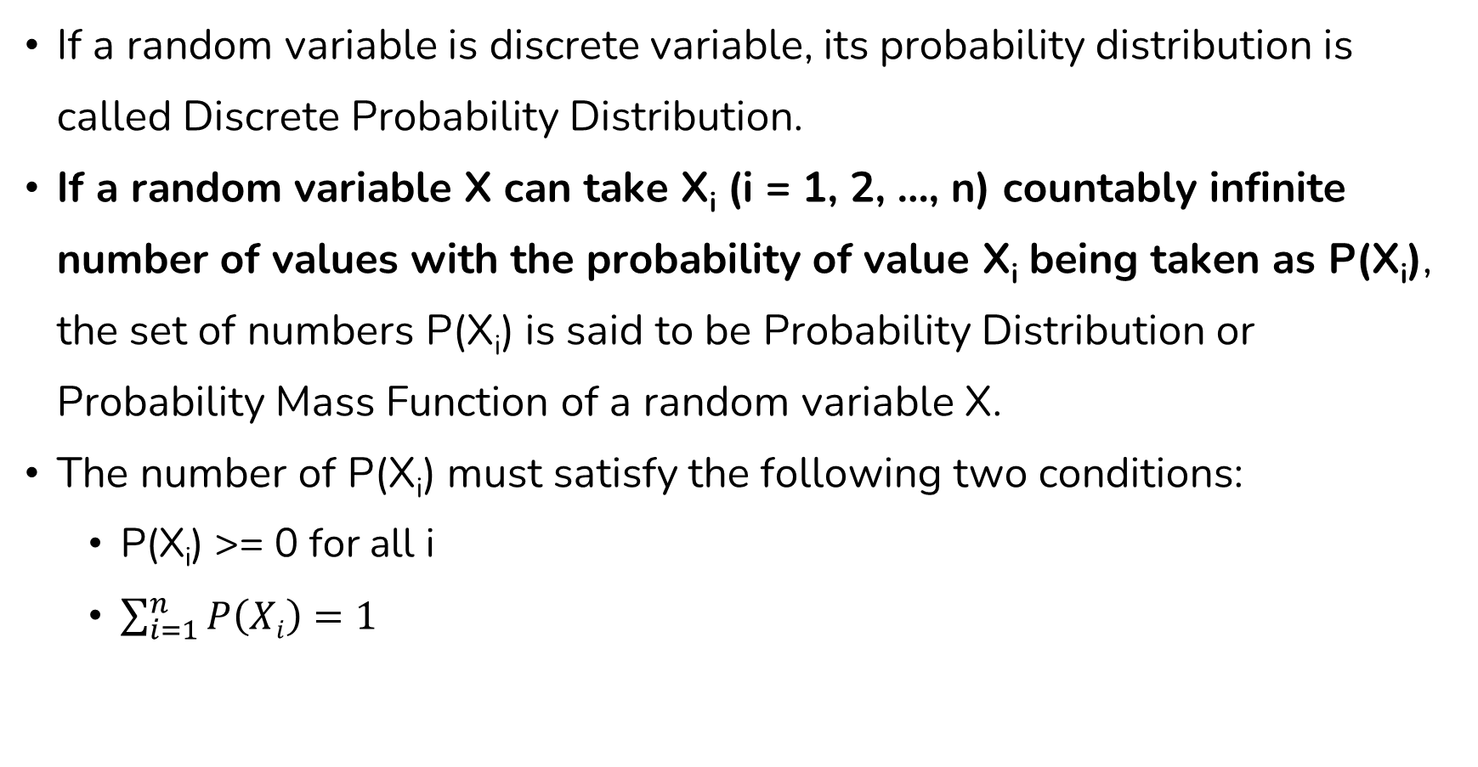
Discrete Probability Function
If a random variable is discrete variable, its probability distribution is called Discrete Probability Distribution.
If a random variable X can take X_{i} (i = 1, 2, …, n) countably infinite number of values with the probability of value X_{i} being taken as P(X_{i}), the set of numbers P(X_{i}) is said to be Probability Distribution or Probability Mass Function of a random variable X.
The number of P(X_{i}) must satisfy the following two conditions:
P(X_{i}) >= 0 for all i
$\sum_{i=1}^{n}{P\left(Xi\right)}=1$

Slide 12
Discrete Probability Function
Example: If we flip a coin two times then we can have four possible outcomes/ Sample Space: HH, HT, TH, TT.
Let X be a random variable that represents the number of heads in above experiment.
The random variable X can only take values 0, 1 or 2. So it is discrete random variable.
The probability distribution for this statistical experiment appears below.
Number of Head: X | 0 | 1 | 2
P(X) | 0.25 | 0.5 | 0.25

Slide 13
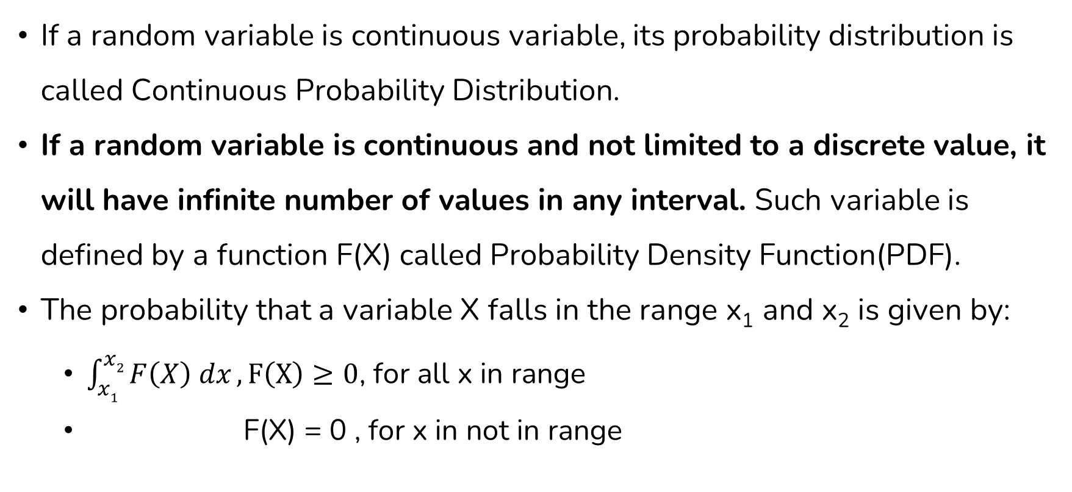
Continuous Probability Function
If a random variable is continuous variable, its probability distribution is called Continuous Probability Distribution.
If a random variable is continuous and not limited to a discrete value, it will have infinite number of values in any interval. Such variable is defined by a function F(X) called Probability Density Function(PDF).
The probability that a variable X falls in the range x₁ and x₂ is given by:
$\int_{x1}^{x2}{F\left(X\right) dx}, F\left(X\right)≥0$, for all x in range
F(X) = 0 , for x in not in range

Slide 14
End of Lecture 14

Slide 15
Random Number Generation

